Slide 1
Introduction to CML
Continuous Machine Learning

Slide 2
References
Continuous Machine Learning (CML) is CI/CD for Machine Learning Projects
Cml.dev
Configuring Github Workflows
https://docs.github.com/en/actions/configuring-and-managing-workflows/configuring-a-workflow
https://docs.github.com/en/actions/reference/workflow-syntax-for-github-actions#jobsjob_idsteps

Slide 3
Tools
Linode.com - $5 a month Linux instance
Codeanywhere.com - Cloud Integrated Development Environment

Slide 4
What is CML?
Continuous Machine Learning (CML) is an open-source library for implementing continuous integration & delivery (CI/CD) in machine learning projects.
Use CML to automate parts of your development workflow, including model training and evaluation, comparing ML experiments across your project history, and monitoring changing datasets.
On every pull request, CML helps you automatically train and evaluate models, then generates a visual report with results and metrics.

Slide 5
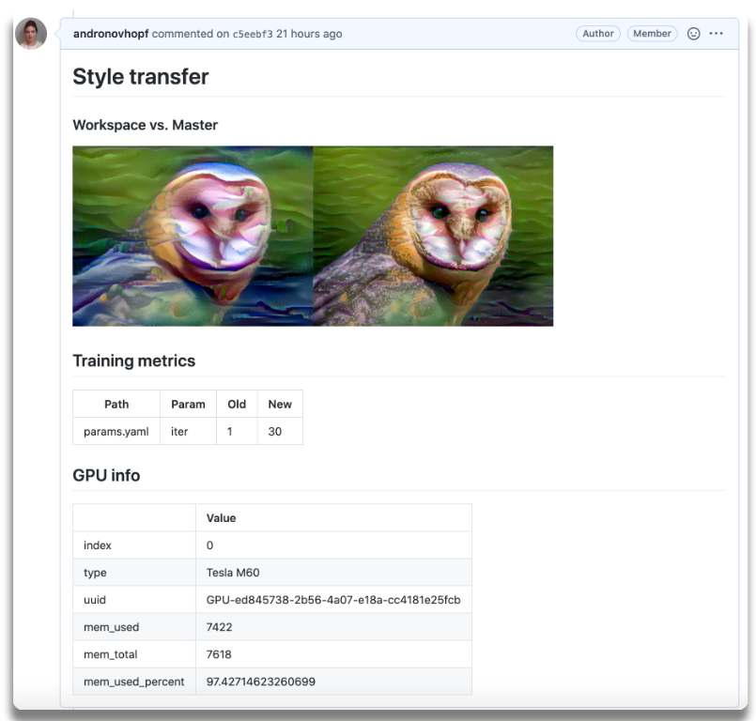
CML in Use
On every pull request, CML helps you automatically train and evaluate models, then generates a visual report with results and metrics.
To the left, an example report for a neural style transfer model.

Slide 6
CML Principles
GitFlow for data science. Use GitLab or GitHub to manage ML experiments, track who trained ML models or modified data and when. Codify data and models with DVC instead of pushing to a Git repo.
Auto reports for ML experiments. Auto-generate reports with metrics and plots in each Git Pull Request. Rigorous engineering practices help your team make informed, data-driven decisions.
No additional services. Build your own ML platform using just GitHub or GitLab and your favorite cloud services: AWS, Azure, GCP. No databases, services or complex setup needed.

Slide 7
Workflow Actions and GitHub
Workflows are custom automated processes that you can set up in your repository to build, test, package, release, or deploy any project on GitHub.
With workflows you can automate your software development life cycle with a wide range of tools and services.
Workflow files use YAML syntax, and must have either a .yml or .yaml file extension.

Slide 8
YAML
YAML is an acronym for 'Yet Another Markup Language', but is now more commonly referred to as 'YAML Ain't Markup Language' … think GNU is not Unix.
YAML is a data-orientated, human readable, serializable language.
YAML borrows from other languages.
Scalars, lists, and associative arrays are based on Perl.
The document separator “---” is based on MIME.
Escape sequences are based on C.
Whitespace wrapping is based on HTML.
YAML relies on indentation to group common elements and provides data hierarchy.
NOTE: YAML indentation uses [spaces], not [tabs].
NOTE: Spaces must be placed between all keys and values as well.

Slide 9
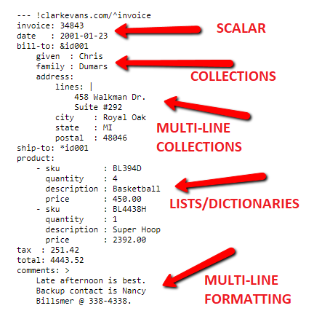
YAML Sample
https://www.codeproject.com/Articles/1214409/Learn-YAML-in-five-minutes

Slide 10
Scalers
Scalars, or variables, are defined using a colon and a
space.integer: 25
string: "25"
float: 25.0
boolean: Yes

Slide 11
Lists
Associative arrays and lists can be defined using a conventional block format (or an inline format that is similar to JSON).
--- # Shopping List in Block Format
milk
eggs
Juice
--- # Shopping List in Inline Format
[milk, eggs, juice]

Slide 12
CML Workflow Sample
This is the gist of the CML workflow: when you push changes to your GitHub repository, the workflow in your .github/workflows/cml.yaml file gets run and a report generated.
The CML functions let you display relevant results from the workflow, like model performance metrics and vizualizations, in GitHub checks and comments. What kind of workflow you want to run, and want to put in your CML report, is up to you.

Slide 13
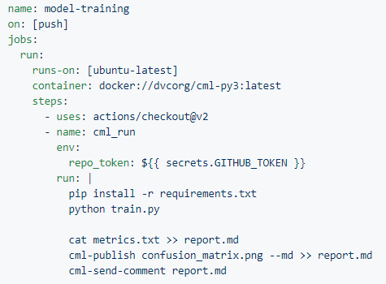
Workflow Action

Slide 14
Line-by-Line
Next, we will break the CML sample script down, line by line.

Slide 15

Name
The name of your workflow.
GitHub displays the names of your workflows on your repository's actions page.
If you omit name, GitHub sets it to the workflow file path relative to the root of the repository.

Slide 16

On <triggering event>
The name of the GitHub event that triggers the workflow.
You can provide a single event string, array of events, array of event types, or an event configuration map that schedules a workflow or restricts the execution of a workflow to specific files, tags, or branch changes.
This is a required field and there are many events that can trigger a workflow.
Trigger the workflow on push or pull request on: [push, pull_request]

Slide 17
Workflow Events
check_run
check_suite
create
delete
deployment
deployment_status
fork
gollum
issue_comment
issues
label
milestone
page_build
project
project_card
project_column
public
pull_request
pull_request_review
pull_request_review_comment
pull_request_target
push
registry_package
release
status
watch
workflow_run

Slide 18

Jobs
A workflow run is made up of one or more jobs. Jobs run in parallel by default. To run jobs sequentially, you can define dependencies on other jobs using the jobs.<job_id>.needs keyword.
Each job runs in an environment specified by runs-on.
You can run an unlimited number of jobs as long as you are within the workflow usage limits.

Slide 19

Run
Runs command-line programs using the operating system's shell. If you do not provide a name, the step name will default to the text specified in the run command.
Commands run using non-login shells by default. You can choose a different shell and customize the shell used to run commands.
Each run keyword represents a new process and shell in the runner environment. When you provide multi-line commands, each line runs in the same shell.

Slide 20

Runs-on
The underlying virtual machine to run the job on. The machine can be either a GitHub-hosted runner, or a self-hosted runner. This machine may also host a (Docker) container if specified.
Virtual environment | YAML workflow label
Windows Server 2019 | windows-latest or windows-2019
Ubuntu 20.04 | ubuntu-20.04
Ubuntu 18.04 | ubuntu-latest or ubuntu-18.04
Ubuntu 16.04 | ubuntu-16.04
macOS Catalina 10.15 | macos-latest or macos-10.15

Slide 21

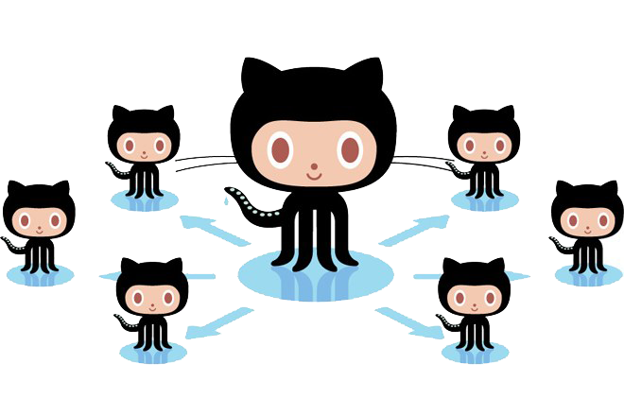
Runners!
The runner is the application that runs a job from a GitHub Actions workflow. The runner can run on the hosted machine pools or run on self-hosted environments.

Slide 22
GitHub Hosted Runners
Receive automatic updates for the operating system, preinstalled packages and tools, and the self-hosted runner application.
Are managed and maintained by GitHub.
Provide a clean instance for every job execution.
Use free minutes on your GitHub plan, with per-minute rates applied after surpassing the free minutes.

Slide 23
Self-Hosted Runners
Receive automatic updates for the self-hosted runner application only. You are responsible updating the operating system and all other software.
Can use cloud services or local machines that you already pay for.
Are customizable to your hardware, operating system, software, and security requirements.
Don't need to have a clean instance for every job execution.
Are free to use with GitHub Actions, but you are responsible for the cost of maintaining your runner machines.

Slide 24
Self-Hosted Runners
Let's dive into self-hosted runners a bit more...

Slide 25
Self-Hosted Runner Requirements
You can install and run the self-hosted runner application on the machine.
The machine can communicate with GitHub Actions.
The machine has enough hardware resources for the type of workflows you plan to run. The self-hosted runner application itself only requires minimal resources.
Note: If you want to run workflows that use Docker container actions or service containers, you must use a Linux machine and Docker must be installed.

Slide 26
Self-Hosted Supported Operating Systems
Linux
Red Hat Enterprise Linux 7
CentOS 7
Oracle Linux 7
Fedora 29 or later
Debian 9 or later
Ubuntu 16.04 or later
Linux Mint 18 or later
openSUSE 15 or later
SUSE Enterprise Linux (SLES) 12 SP2 or later
Windows
Windows 7 64-bit
Windows 8.1 64-bit
Windows 10 64-bit
Windows Server 2012 R2 64-bit
Windows Server 2016 64-bit
Windows Server 2019 64-bit
MacOS
macOS 10.13 (High Sierra) or later

Slide 27
Self-Hosted Runner Communication
The self-hosted runner polls GitHub to retrieve application updates and to check if any jobs are queued for processing.
The self-hosted runner uses a HTTPS long poll that opens a connection to GitHub for 50 seconds, and if no response is received, it then times out and creates a new long poll.
The application must be running on the machine to accept and run GitHub Actions jobs.

Slide 28
container
The Docker image to use as the container to run the action. The value can be the Docker Hub image name or a public docker registry name.
If you do not set a container, all steps will run directly on the host specified by runs-on unless a step refers to an action configured to run in a container.
We will look at the docker container in the next slide...

Slide 29
Docker Hub
Docker Hub is the world's largest library and community for container images
Browse over 100,000 container images from software vendors, open-source projects, and the community.
Let's look at Docker Hub...
https://hub.docker.com/search?q=dvcorg%2Fcml-py3&type=image

Slide 30

Review
The runs-on statement defines the runner.
The runner may be self-hosted or hosted (typically a virtual machine).
The runner hosts a container.

Slide 31
steps
A job contains a sequence of tasks called steps.
Steps can run commands, run setup tasks, or run an action in your repository, a public repository, or an action published in a Docker registry.
Not all steps run actions, but all actions run as a step. Each step runs in its own process in the runner environment and has access to the workspace and filesystem.
Because steps run in their own process, changes to environment variables are not preserved between steps. GitHub provides built-in steps to set up and complete a job.

Slide 32

uses
Selects an action to run as part of a step in your job. An action is a reusable unit of code. You can use an action defined in the same repository as the workflow, a public repository, or in a published Docker container image.
The checkout action is specified in this script:
https://github.com/marketplace/actions/checkout

Slide 33

name
The name of the job displayed on GitHub.

Slide 34

env
Identifies a section in the script which is a map of environment variables that are available to all jobs and steps in the workflow.
The term map is typical when describing key/value pairs. (Think Javascript objects)

Slide 35
Repro_token
GitHub provides a token that you can use to authenticate on behalf of GitHub Actions.
GitHub automatically creates a GITHUB_TOKEN secret to use in your workflow. You can use the GITHUB_TOKEN to authenticate in a workflow run.
Before each job begins, GitHub fetches an installation access token for the job. The token expires when the job is finished.
To use the GITHUB_TOKEN secret, you must reference it in your workflow file. Using a token might include passing the token as an input to an action that requires it, or making authenticated GitHub API calls.

Slide 36


run
Runs command-line programs using the operating system's shell.
Run followed by a pipe '|' designates a multi-line command.

Slide 37
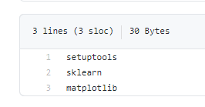
pip
pip install -r requirements.txt
installs the libraries listed in the requirements.txt file

Slide 38

python
This command runs the training code contained in train.py

Slide 39
cat
On Unix-like operating systems, the cat command reads data from files, and outputs their contents.
It is the simplest way to display the contents of a file at the command line.
The ">>" operator appends the output to the "report.md" file.

Slide 40
Cml-publish
Publish an image for writing to CML report.
The library comes pre-installed on the CML docker image.
In the above example, note the field container: docker://dvcorg/cml-py3:latest specifies the CML Docker image with Python 3 will be pulled by the GitHub Actions runner.
The next slide lists all of the CML functions.

Slide 41
CML Functions
CML provides a number of helper functions to help package outputs from ML workflows, such as numeric data and data vizualizations about model performance, into a CML report.
Function | Description | Inputs
cml-send-comment | Return CML report as a comment in your GitHub/GitLab workflow. | <path to report> --head-sha <sha>
cml-send-github-check | Return CML report as a check in GitHub | <path to report> --head-sha <sha>
cml-publish | Publish an image for writing to CML report. | <path to image> --title <image title> --md
cml-tensorboard-dev | Return a link to a Tensorboard.dev page | --logdir <path to logs> --title <experiment title> --md

Slide 42
Cml-send-comment
Sends the resulting report in email.

Slide 43
Let's Configure the Workflow!
The following slides step through the process of installing the workflow action.

Slide 44
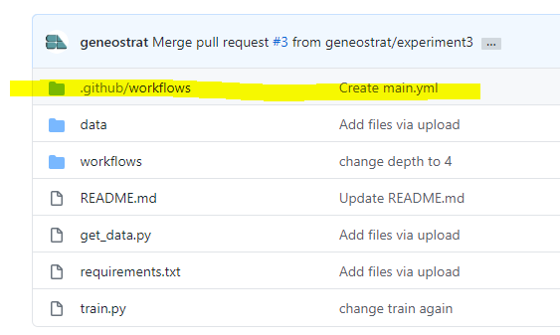
Where Workflows Live
You can create more than one workflow in a repository. You must store workflows in the .github/workflows directory in the root of your repository.

Slide 45
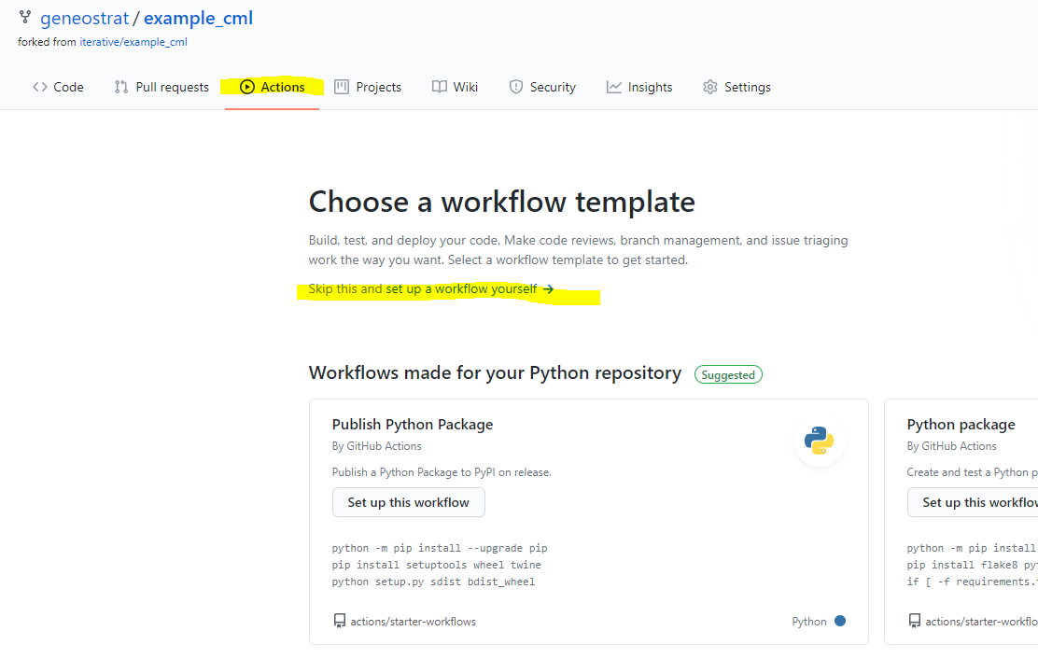
Choose Workflow Template
Setup the workflow template yourself.

Slide 46
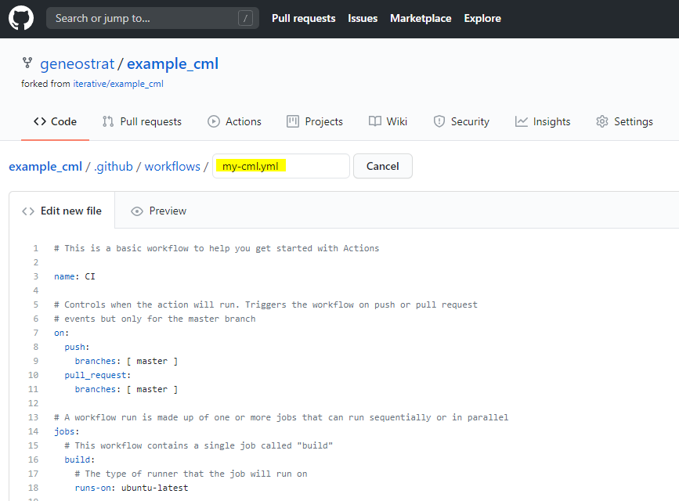
Create the Action File
Provide a name for your YML file.
Copy the sample CML action script or write your own.

Slide 47
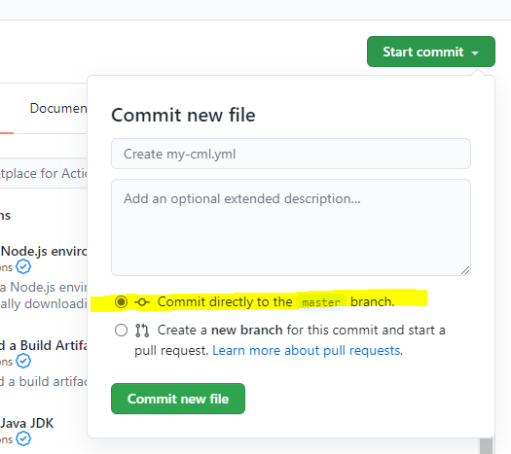
Commit the Action File
Note: You have to commit the action file to the [master] branch or the action file will not participate in the GitHub workflow system.

Slide 48
No Action Taken
I created the action file in the same branch that I edited the training file. I didn't expect the action to be invoked on this initial check in.
A subsequent check in did not invoke the workflow either.

Slide 49
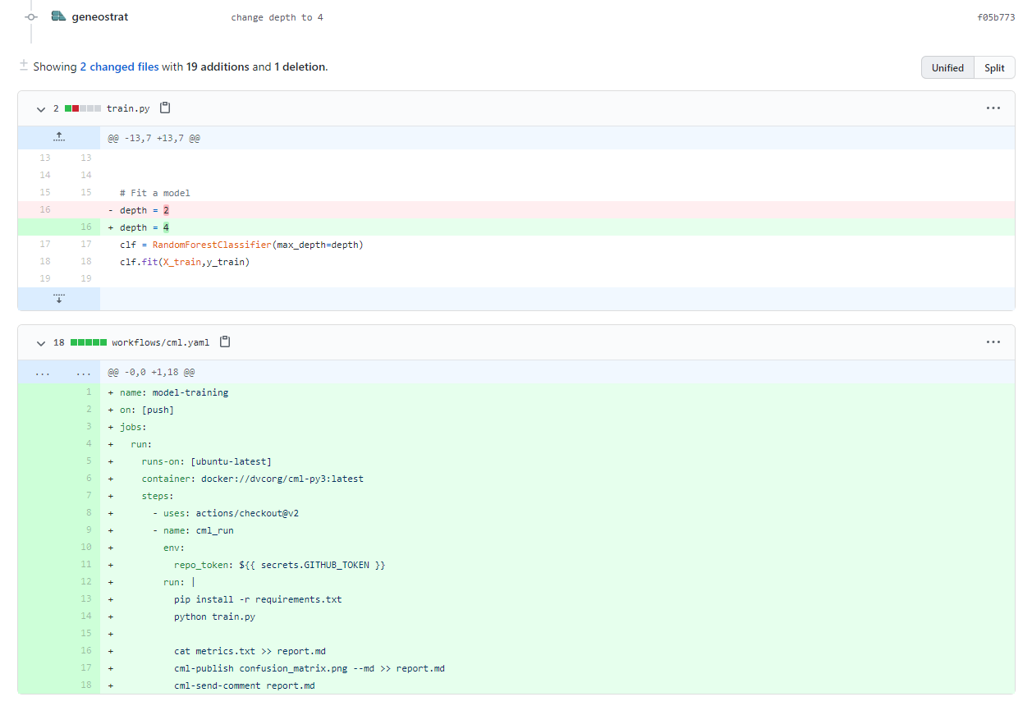
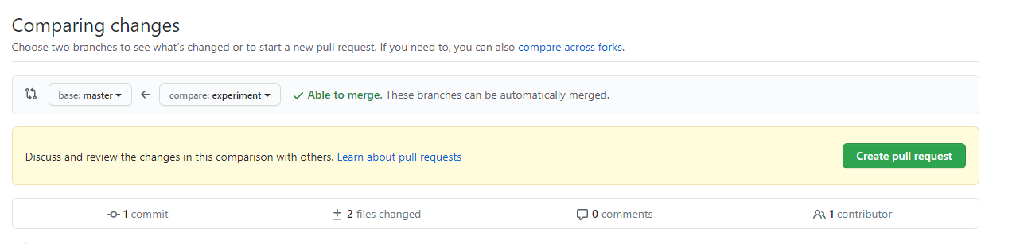
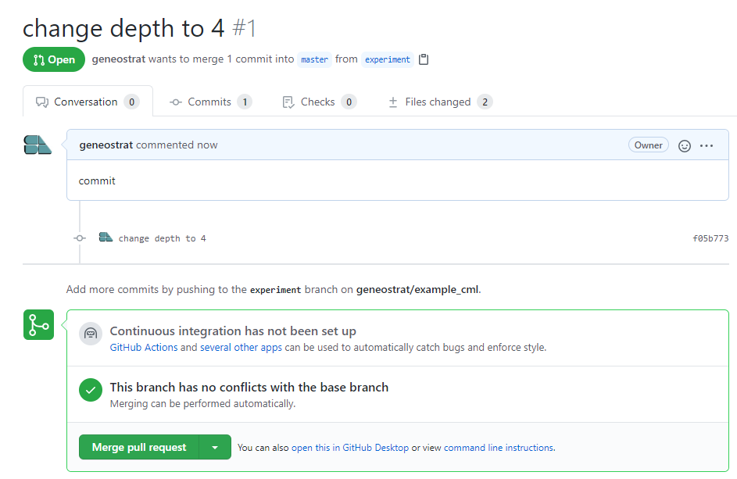
Not Committed to Master Branch

Slide 50
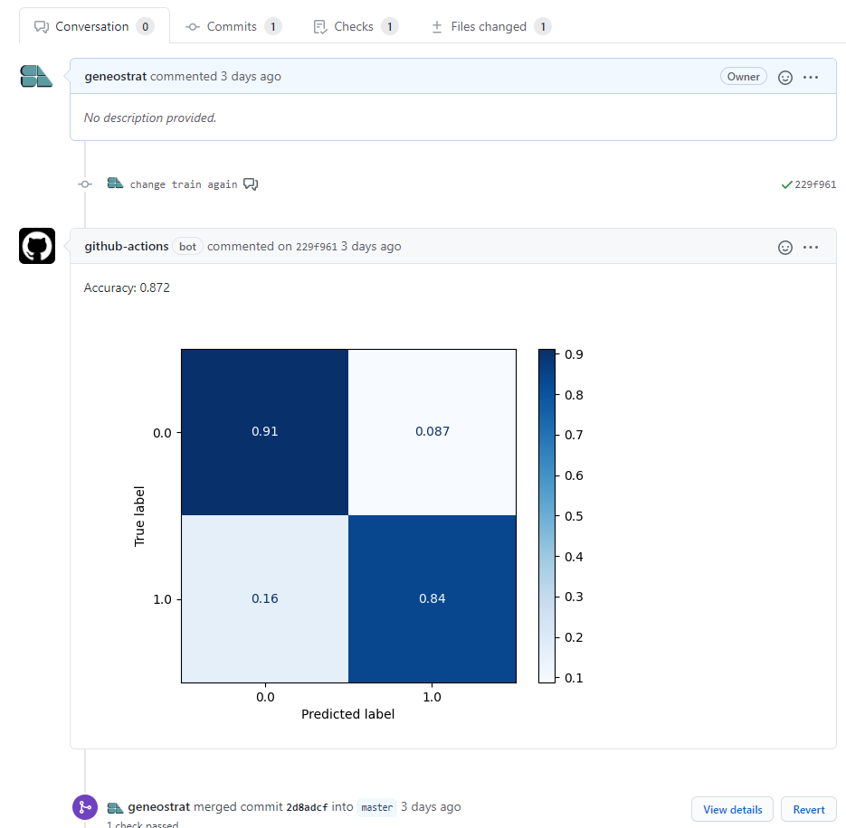
Successul Commit and Action

Slide 51
Live Demo!
Let's make a change and check it in!

Slide 52

What’s Next?
Now that we've been introduced to CML, it may be time to take a look at Data Version Control (DVC).

